Slide 1
Ames Housing Project
by Casey Liu

Slide 2
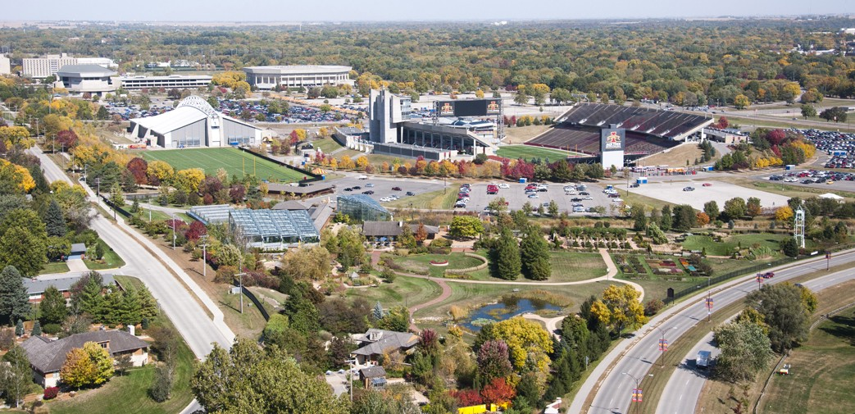
Problem statement
I have datasets of Ames housing. My goal is to use the datasets to predict the price of houses at sale and identify the important factors that have impact on to the value of houses. The Ames Housing Dataset is an exceptionally detailed and robust dataset with over 70 columns of different features relating to houses. I am going to process the data and create a regression model based on the Dataset.
Ames, Iowa

Slide 3
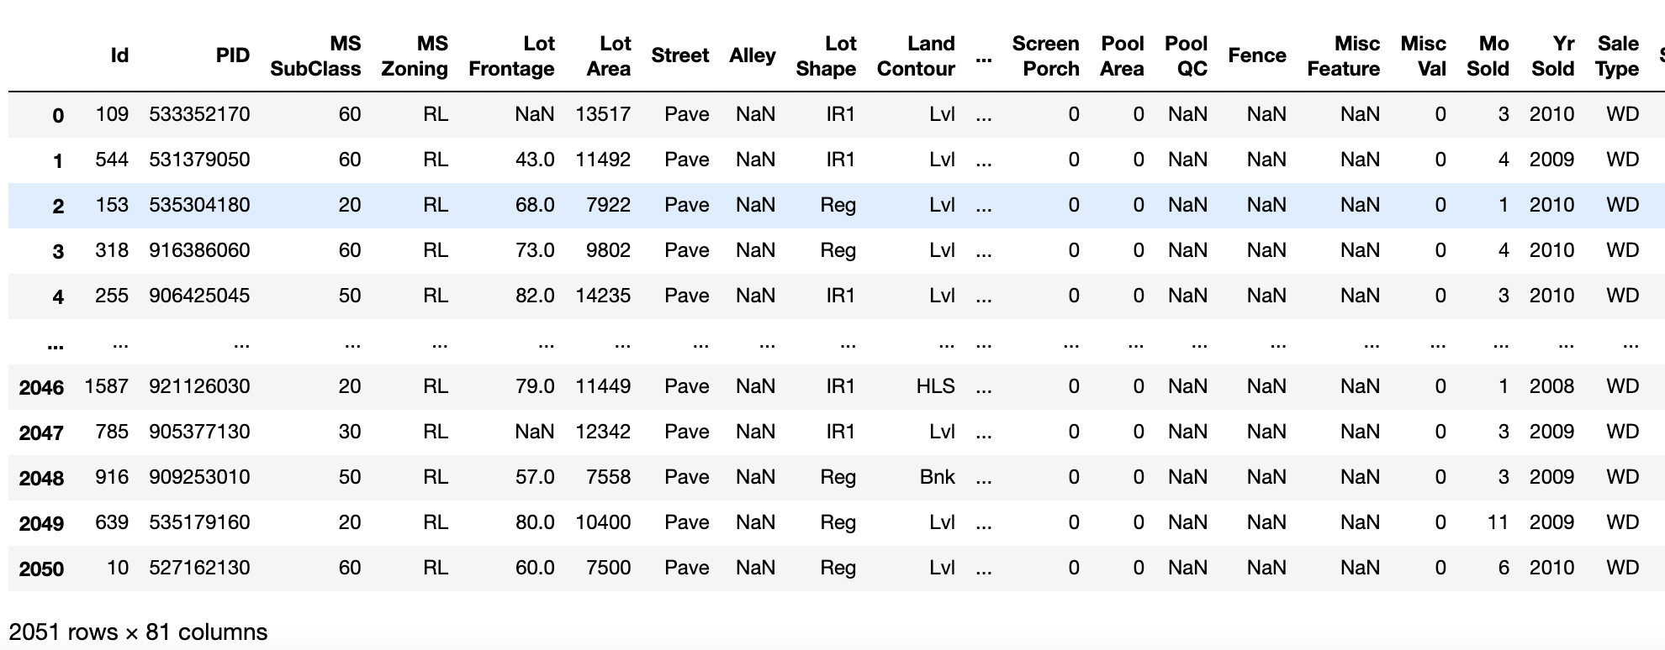
Dataset
Data set contains information from the Ames Assessor’s Office used in computing assessed values for individual residential properties sold in Ames, IA from 2006 to 2010
81 columns and 2051 rows of housing data
Describe features of houses and the sale prices
Include nominal, ordinal, discrete and continuous variables

Slide 4
Data Cleaning
Deal with null values (replace missing value as NA or 0)
Transform objects to numbers
Transform categorical variables to ordinal
For example : 'NA':0, 'Po':1, 'Fa':2, 'TA':3, 'Gd':4, 'Ex':5
Combine some columns
For example: get “Total Square Feet”, “Total bathrooms”
Identify if the house has certain feature
For example: if the house has Central Air, Garage, Fence
Create new column based on the date from existing columns
For example: Calculate the age of the house based on “Year Built”

Slide 5
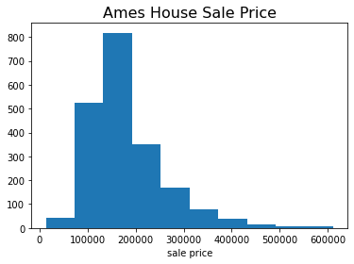
Exploratory Data Analysis
count 2051.000000
mean 181469.701609
std 79258.659352
min 12789.000000
max 611657.000000
Name: SalePrice, dtype: float64

Slide 6
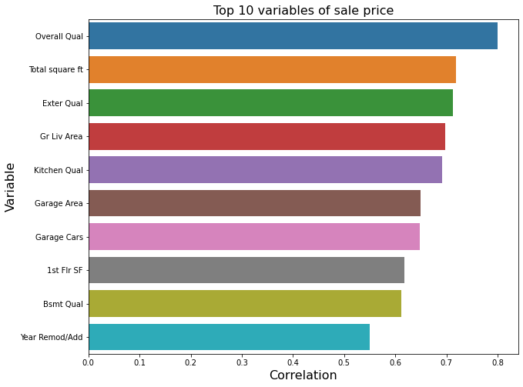
Exploratory Data Analysis
Overall quality
Total square feet
Exterior quality
Ground living area
Kitchen quality
Garage area
Garage cars
1st floor square feet
Basement quality
Remodel year

Slide 7
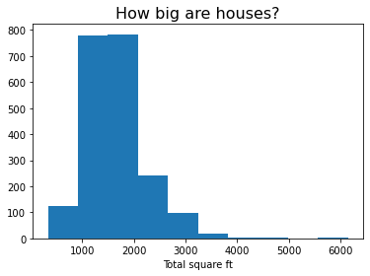
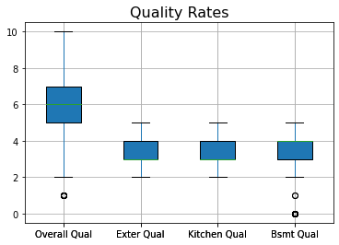
Exploratory Data Analysis

Slide 8
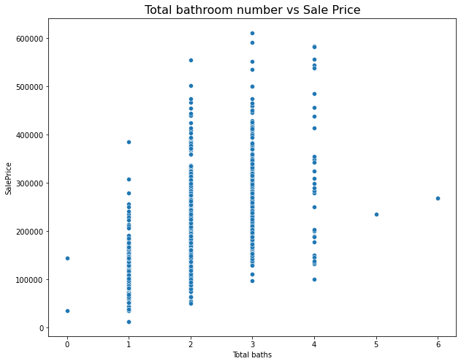
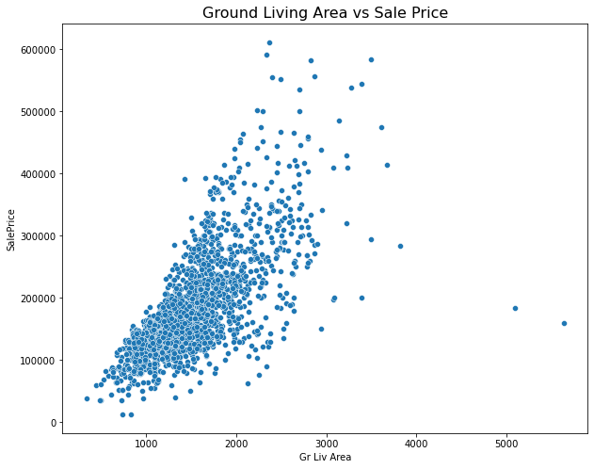
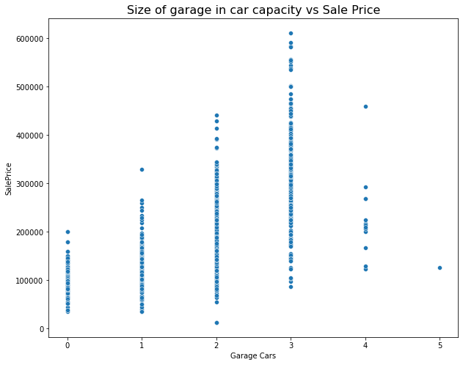
Exploratory Data Analysis

Slide 9
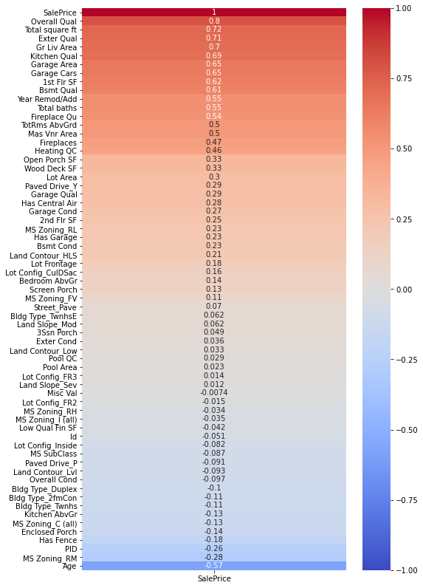
Variable Selection
Select variables whose correlation with Sale Price is positive

Slide 10
Modeling
Train-test split
Scale variable
Run cross validations
Fit Linear Regression, RidgeCV and LassonCV
 | train r2 score | test r2 score | cross_val_score
Linear Regression | 0.8367 | 0.8439 | 0.7772
RidgeCV | 0.8365 | 0.8492 | 0.7853
LassonCV | 0.8306 | 0.8683 | 0.7837
From the r2 scoring above, I find that RidgeCV has the highest score on training and cross validation while the difference between training and testing is lower than LASSO. I decide to run the Ridge model on the unseen data.

Slide 11
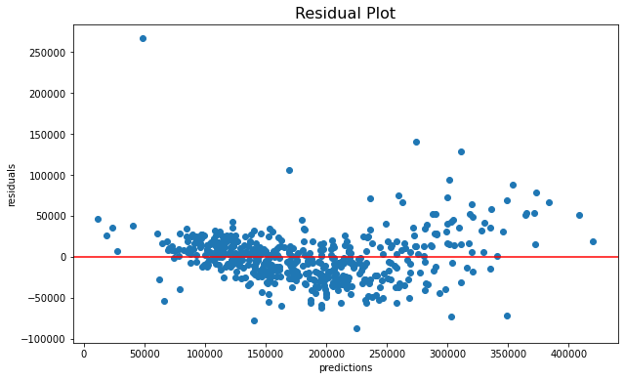
Residual Plot
Residual plot shows the errors corresponding to the predicted values is randomly distributed. It looks normal, so I can go ahead and use the model.

Slide 12
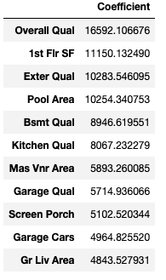
Conclusions
Based on the coefficient, the top 10 variables that can best predict Ames House Sale Price are:
Overall quality
First floor in square feet
Exterior quality
Pool area in square feet
Basement quality
Kitchen quality
Masonry veneer area in square feet
Garage quality
Screen porch area
Size of garage in car capacity
In conclusion, the quality of overall, exterior, basement, kitchen and garage is very important on a house value. The area size of first floor, pool, masonry veneer, screen porch and garage (in car capacity) would also impact the sale price. The real estate developers should pay attention on these factors to get higher house value.

